Slide 1
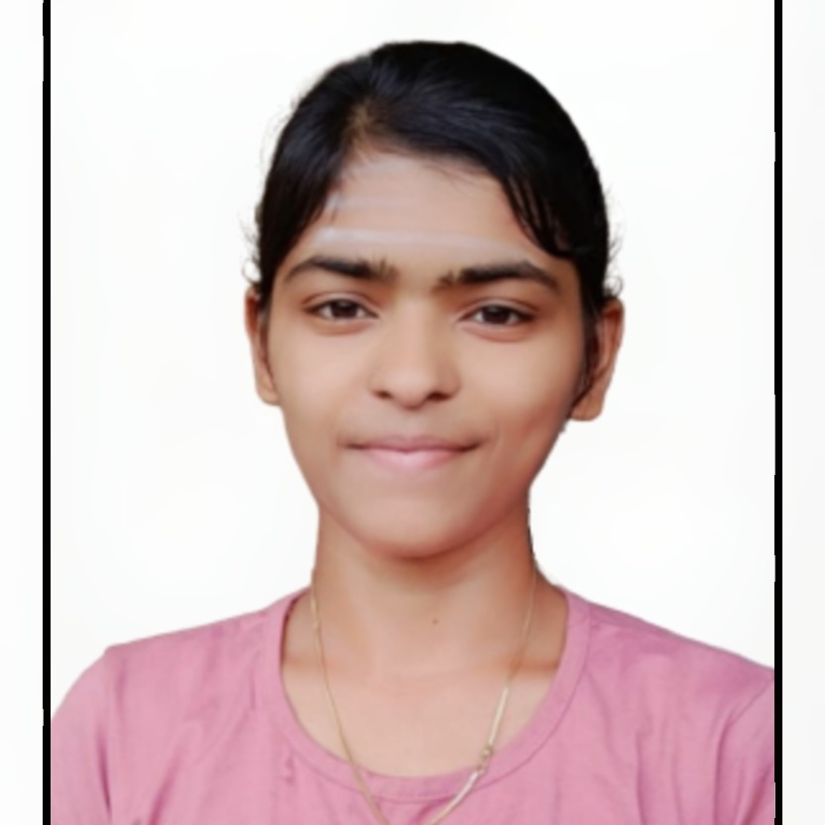

POOJA
Analyst/Software Engineer
Bachelor of technology in
Electrical and Electronics Engineering 2017-2021
Bangalore
Skills
Pooja.q.pooja@Capgemini.com
8618726725
A4
Core Java | Java Basics, OOPS, Spring boot
Database | My SQL, Postgres SQL
UI Tech | HTML 5 & CSS 3
Tool | Agile
OS | Windows 10
IDE’s | Eclipse ,Anypoint Studio, Intellj studio
Functional | Communication, Team management, Peer learning.
1.Decent knowledge on SQL statements and queries.
2.Good understanding of OOPS Concepts, Exception Handling of Java.
3.Worked for a bidirectional sync project to create RAMLs and created its APIs using RAML file.
4.Knowledge of Error handling and batch processing in API led.
5.Working knowledge of batch implementations, to synchronise data between Salesforce and Business database.
Got certified in Agile Certification
Completed Tibco Certification
Completed Cloud Basics & AWS Basics of different services
Completed AWS Partner Migration-Programs and Resources(Level-0)
Completed MuleSoft Developer Level 1

